Slide 1
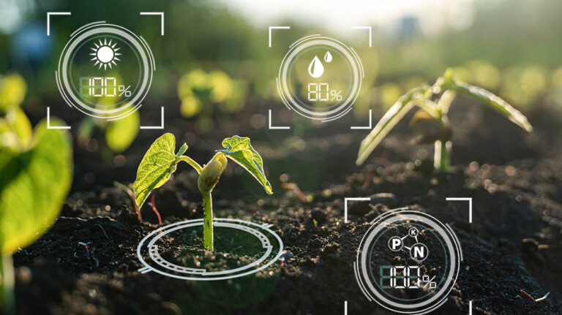
Crop production analysis in india

Slide 2

introduction
Agriculture forms the backbone of India's economy, Understanding crop production trends is vital for enhancing agricultural productivity, ensuring food security, and making informed policy decisions. This project aims to analyze crop production data across various states and districts in India, focusing on different crops, their seasonal variations, and yield patterns over the years.

Slide 3
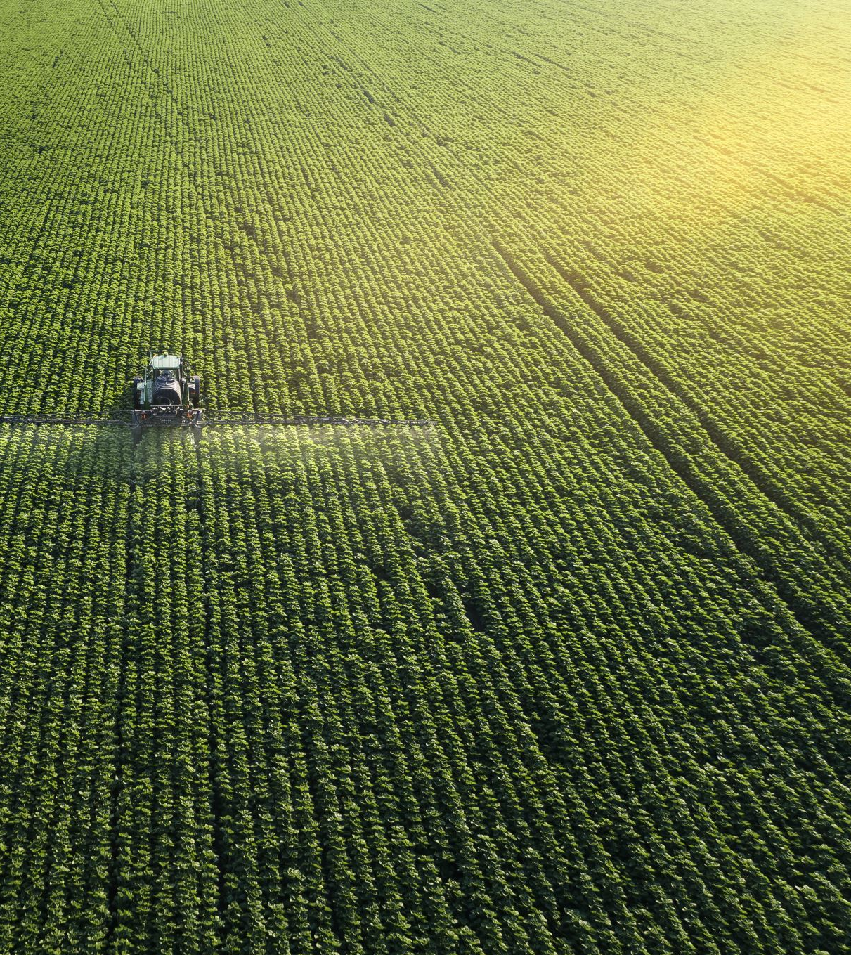
Problem statement
The agricultural sector is crucial for India's economy and food security. However, understanding and optimizing crop production remains a challenge due to various factors such as seasonal variations, regional differences, and changing climatic conditions. There is a need for a comprehensive analysis of crop production data to identify trends, patterns, and influencing factors that can help improve agricultural productivity and sustainability.

Slide 4

Objective
The objective of this project is to analyze crop production data across India to uncover trends and patterns, understand the impact of seasons and regional differences, and develop predictive models for crop yields. The insights gained will help policymakers, researchers, and farmers make data-driven decisions to improve agricultural productivity, ensure food security, and promote sustainable farming practices.

Slide 5

Dashbord

Slide 6
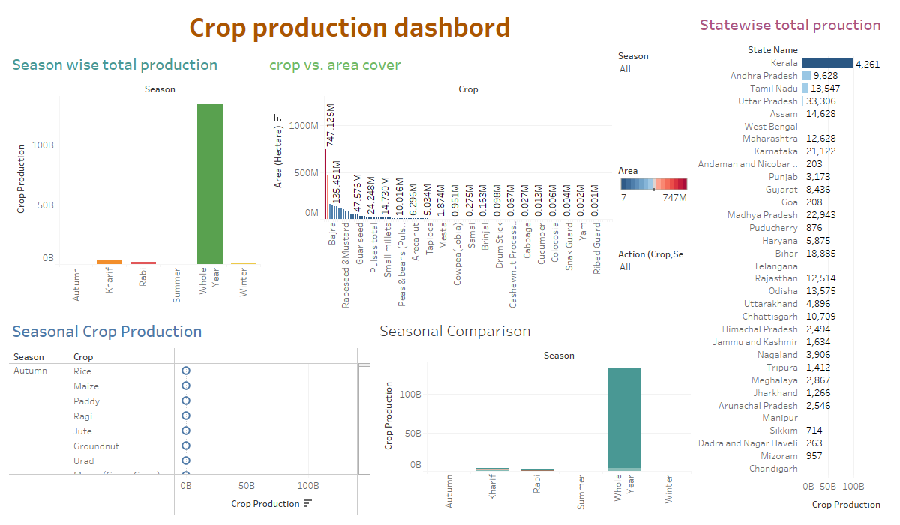

Slide 7
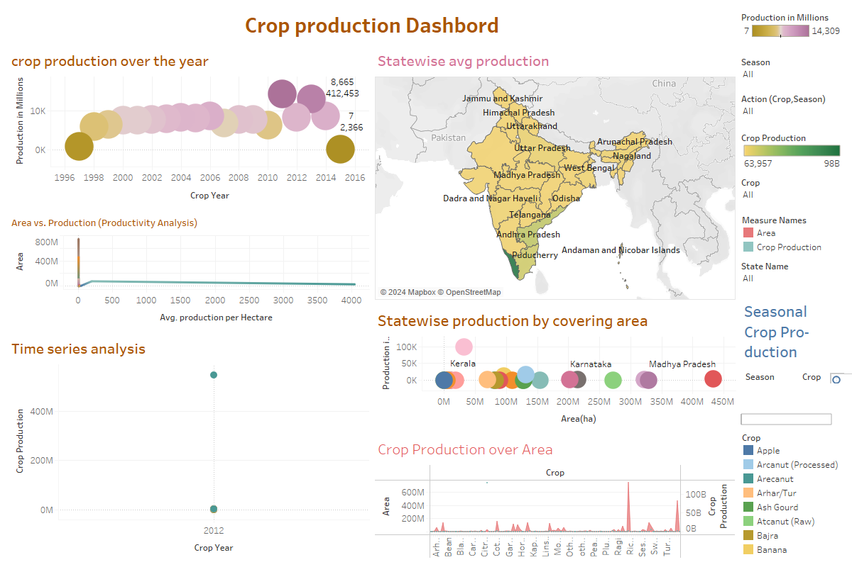

Slide 8
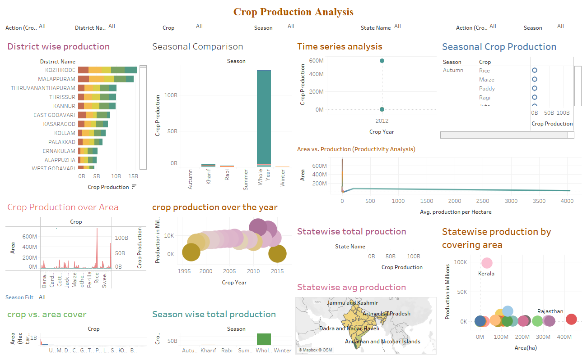

Slide 9


